Slide 1
Escape Room
Group 1
Fade Abdeljaber, Chris Lenell, Deonvell Shed, Luke Wittenkeller

Slide 2


Game Overview
You are stuck in an arena and must somehow escape.
Solve various puzzles and riddles in order to get closer to the escape portal.
Navigate through a 3D environment.

Slide 3
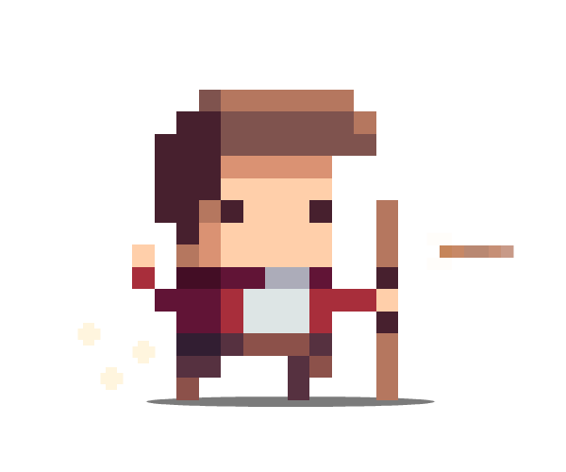

Game Features
Sprites: 2D Images
Inventory: Show current player’s items
Textures: Ability to show different textures on surfaces
Interaction: Player can interact with certain objects
Sound: Sounds to complement player interaction

Slide 4

Under the hood
Code is grouped into three main groups
Engine
Displays the game
Calculates player’s location and actions
Game
Layout of levels
Logic of puzzles
User Interface (UI)
Menu
Inventory

Slide 5
Challenges during development
Adding textures and sprites to the game.
Displaying them correctly
Putting sprites in correct locations
Creating puzzles that will keep the player engaged.
Coming up with puzzle ideas
Implementing the puzzle logic into the game

